Slide 1
Agile project
Lesson 1 – Agile basics

Slide 2
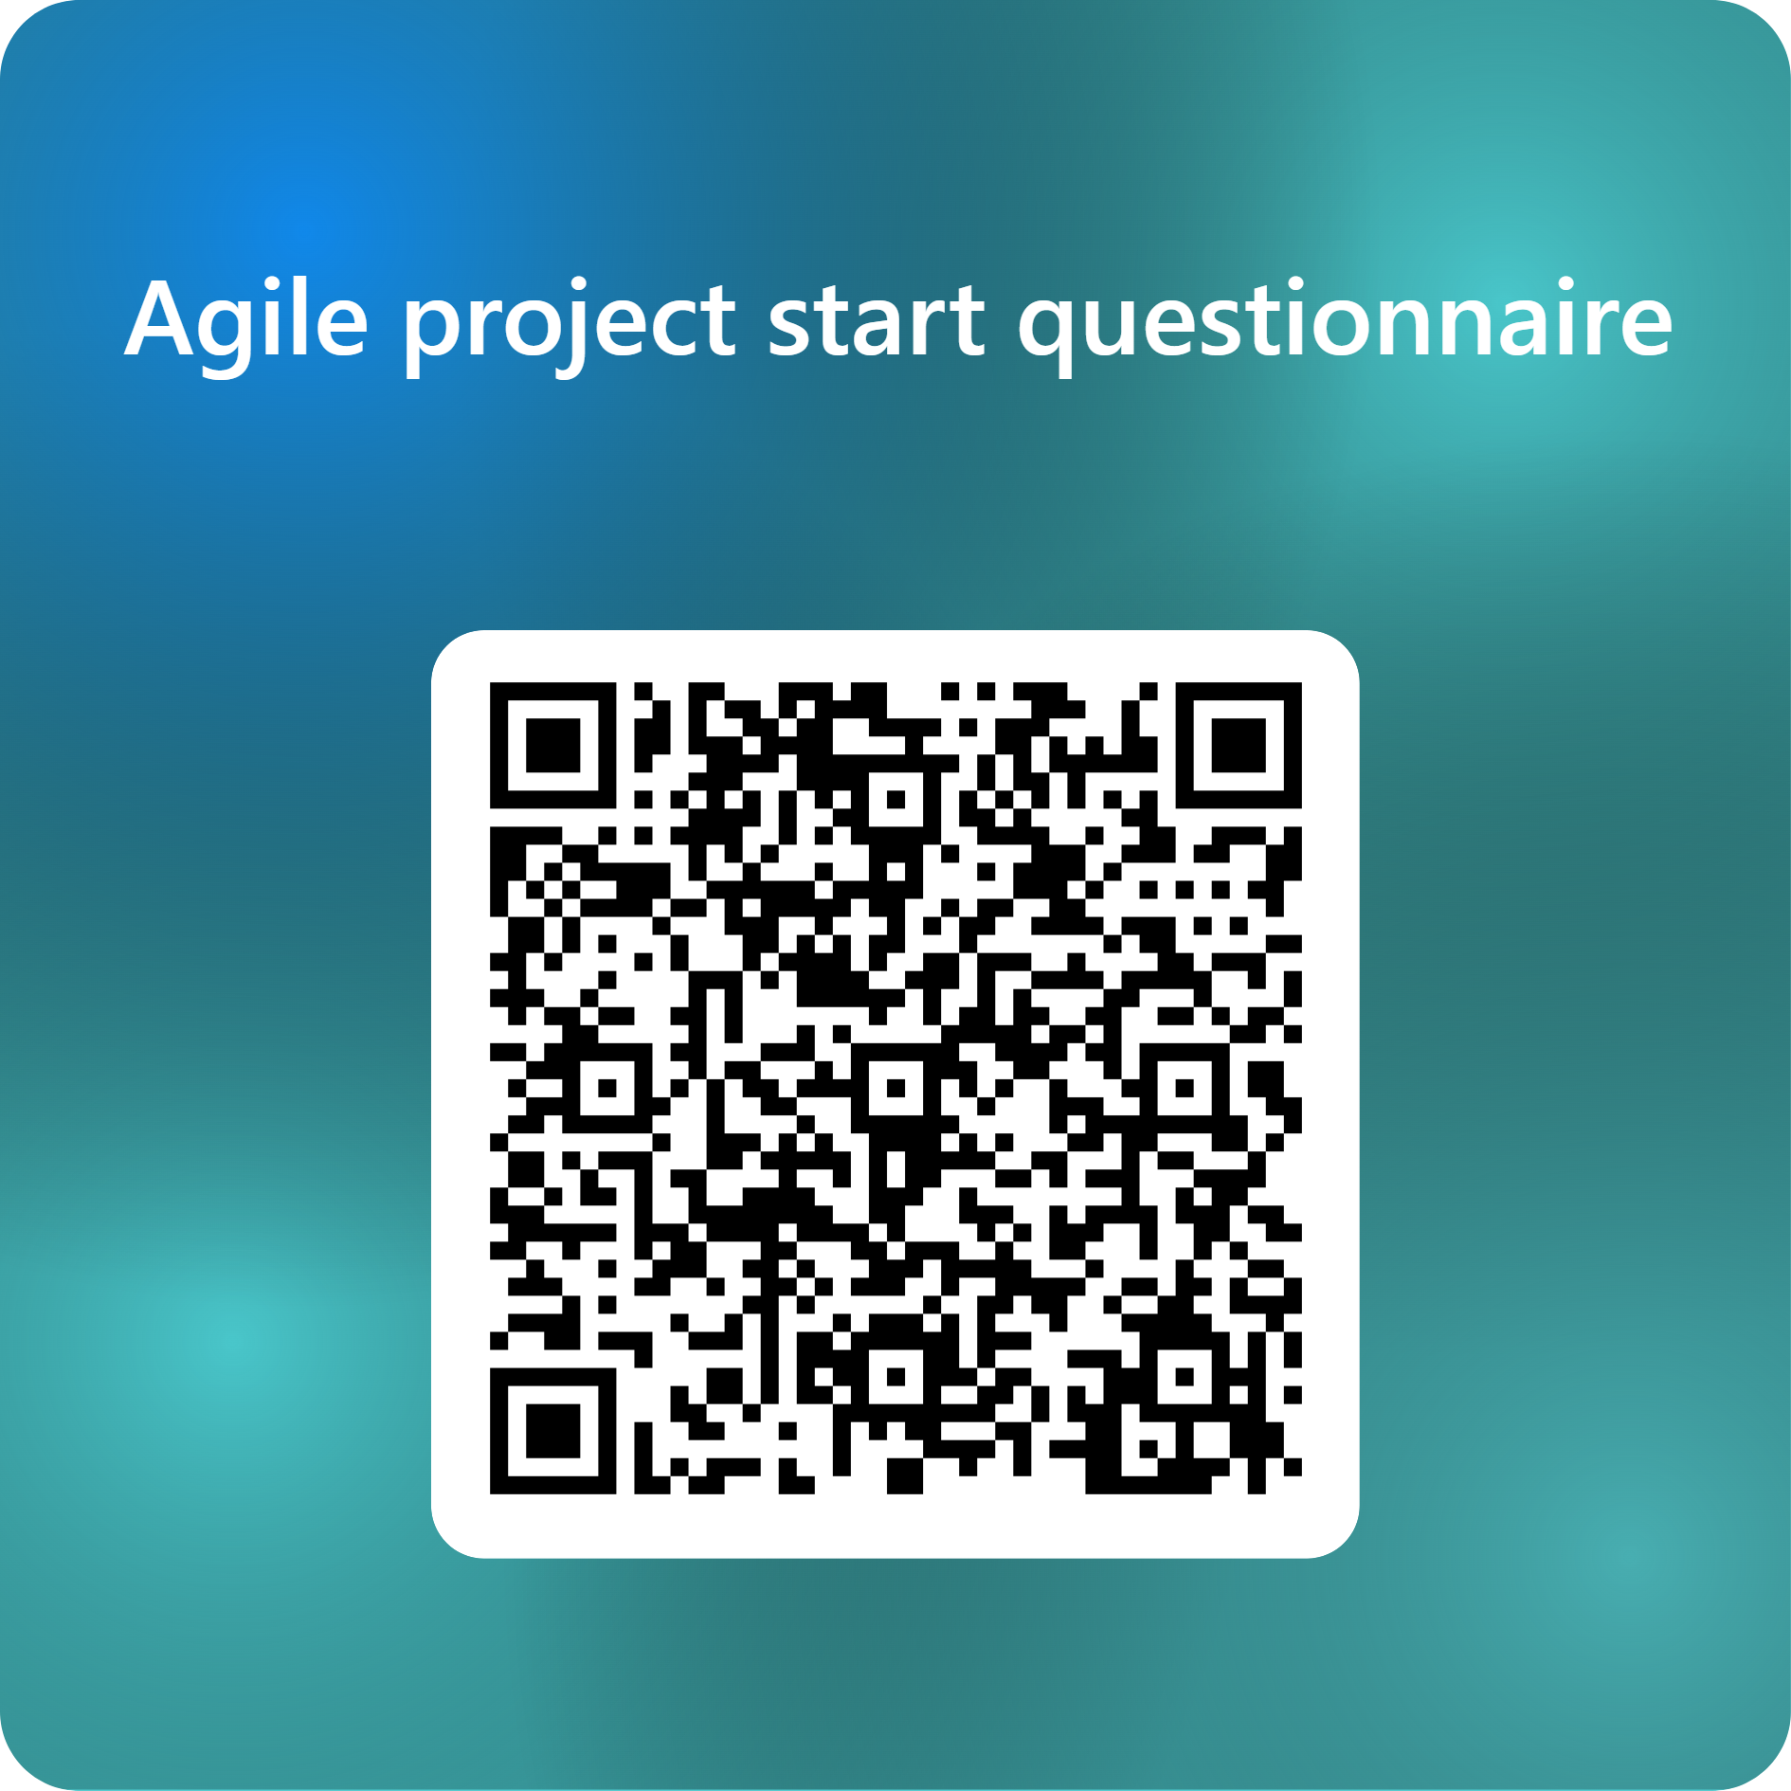

Slide 3
Agile Scrum, what is it?
Scrum is an Agile project management method
  Agile means that you can quickly apply changes
Scrum is based on three pillars
  Transparency – Making the project visible to stakeholders
  Inspection – Frequent check for problems
  Adaptation – Adjusting the process to avoid failures
Scrum uses short periods called sprints
  Sprints are typically two to four weeks long
  Each sprint is meant to finish a set of tasks

Slide 4

Sprints
  A project divided into smaller parts

Slide 5
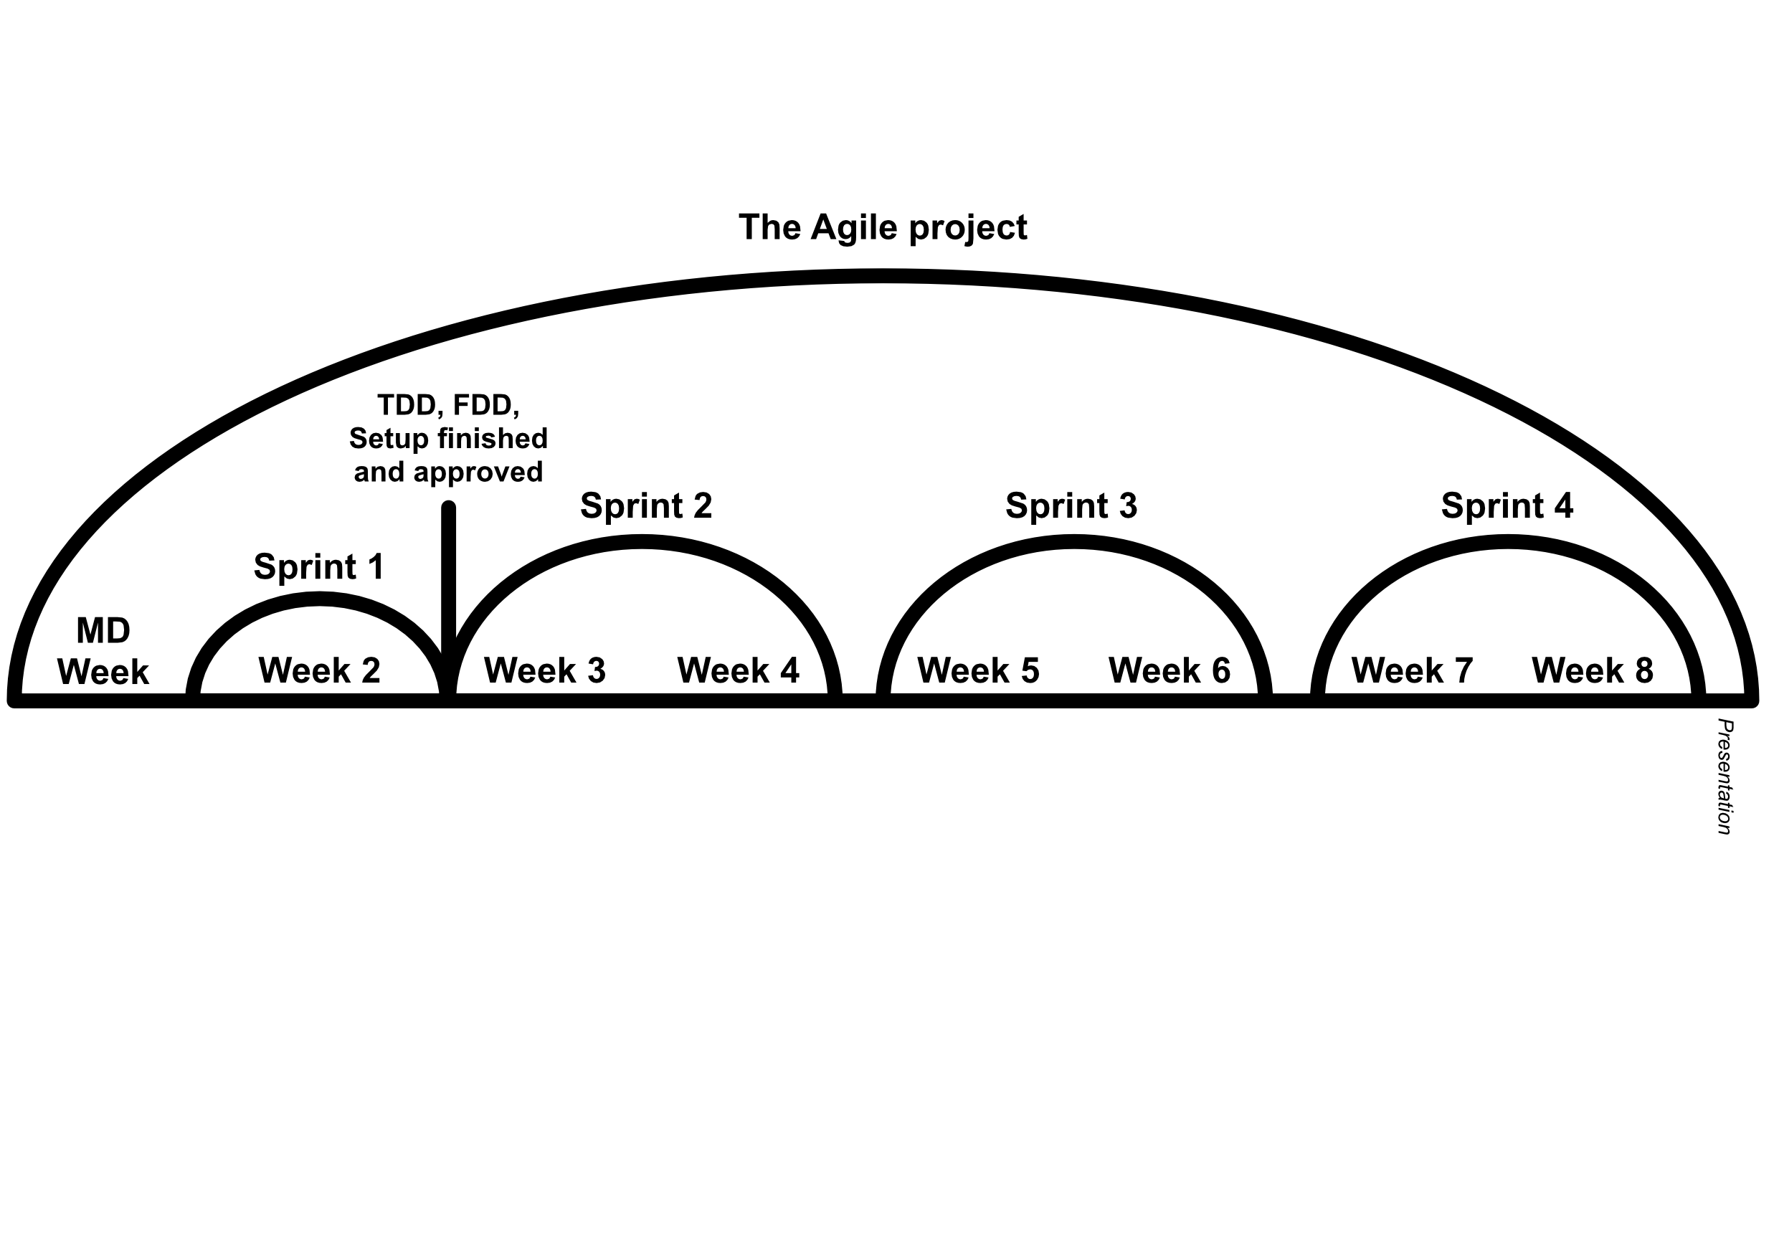
You’re here
Notes:
Ik mis reviews en retrospectives na iedere sprint

Slide 6
Sprints
First sprint:
  Creating documentation (FDD & TDD)
  Making priorities (MoSCoW)
  Setting up the development environment (File/project structure)
Middle sprints:
  New functionalities
Last sprint:
  Full system testing
  Final bugfixes
  Polishing
  Presenting

Slide 7
Weekly roles
Group leader – Takes the lead in the meetings/planning
Secretary – Documents everything that’s said in meetings
Everyone also works on programming

Slide 8

Planboard
  The main attraction

Slide 9
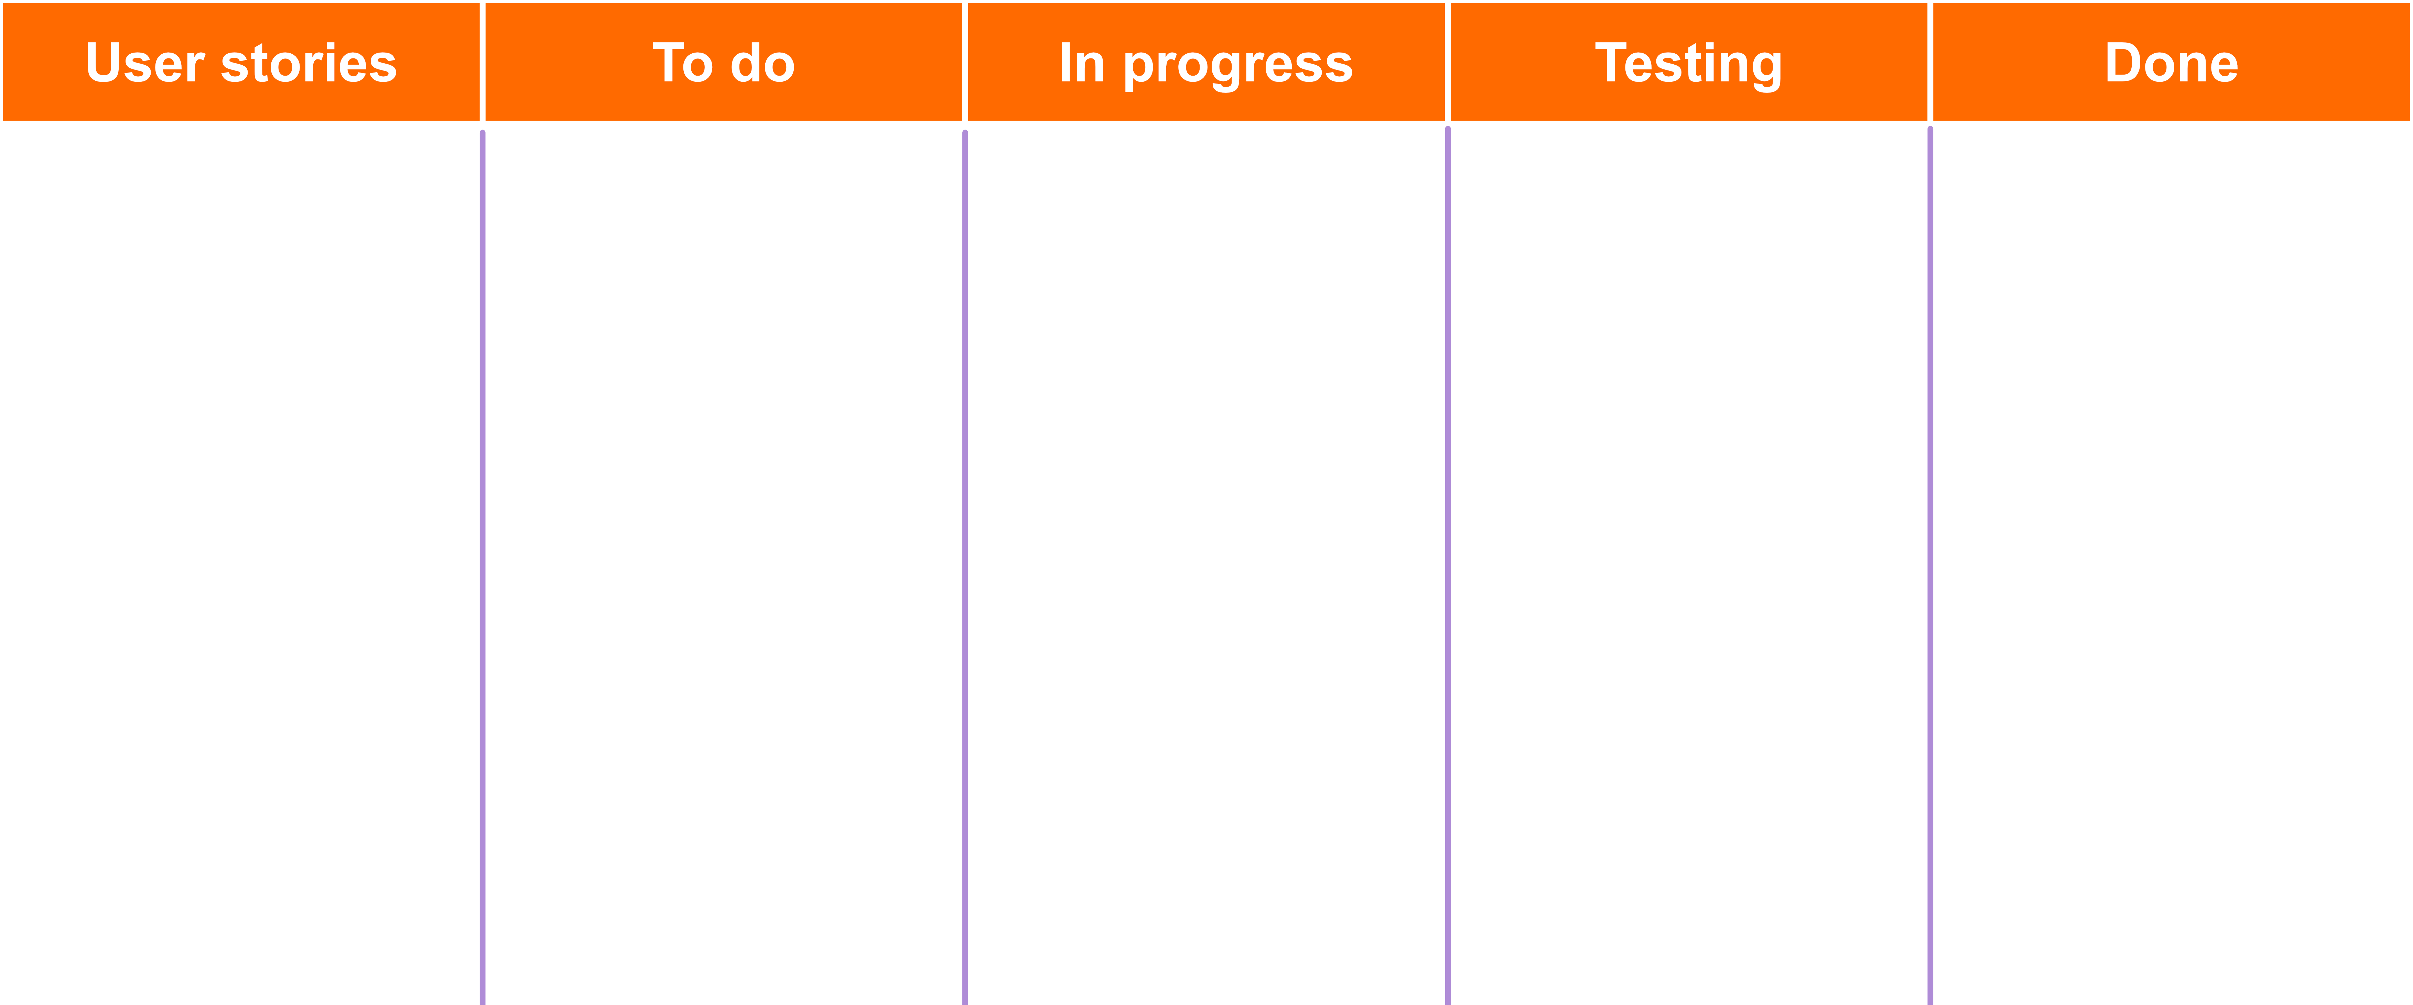
Notes:
User stories zou ik 'backlog' noemen en todo 'sprint backlog (=todo)
'

Slide 10
User stories
A user story:
  As a [role] I would like to [activity] so that [goal] (the last part is optional)
A priority:
  Must have/should have/could have/won’t have
Example:
As a user I would like to share posts to other apps so that my friends can still see them without an account
As a player I would like to see my time on a leaderboard so that I can see how well I did compared to others

Slide 11
As a user I would like to share posts to other apps so that my friends can still see them without an account
Should have

Slide 12
Assignment
Create a Functional Design Document with the use of user stories and a Technical Design Document connected to the FDD
  A user story:
    As a [role] I would like to [activity] so that [goal]
      (the goal is optional)
  A priority:
    Must have/should have/could have/won’t have
  Tips:
    Create a description of your product
    Create a list of functionalities with priorities
    Translate them to user stories using AI.
      Use the user story template as seen above
    Make sure to check if the user stories are correct and complete

Slide 13
Assignment
Create a test form from your design documents which you’ll perform during the third sprint of the project.
  Tips:
    Let an AI translate your design documents into a test (use the template!)
    Discuss the results with your group and adjust them where needed.

Slide 14
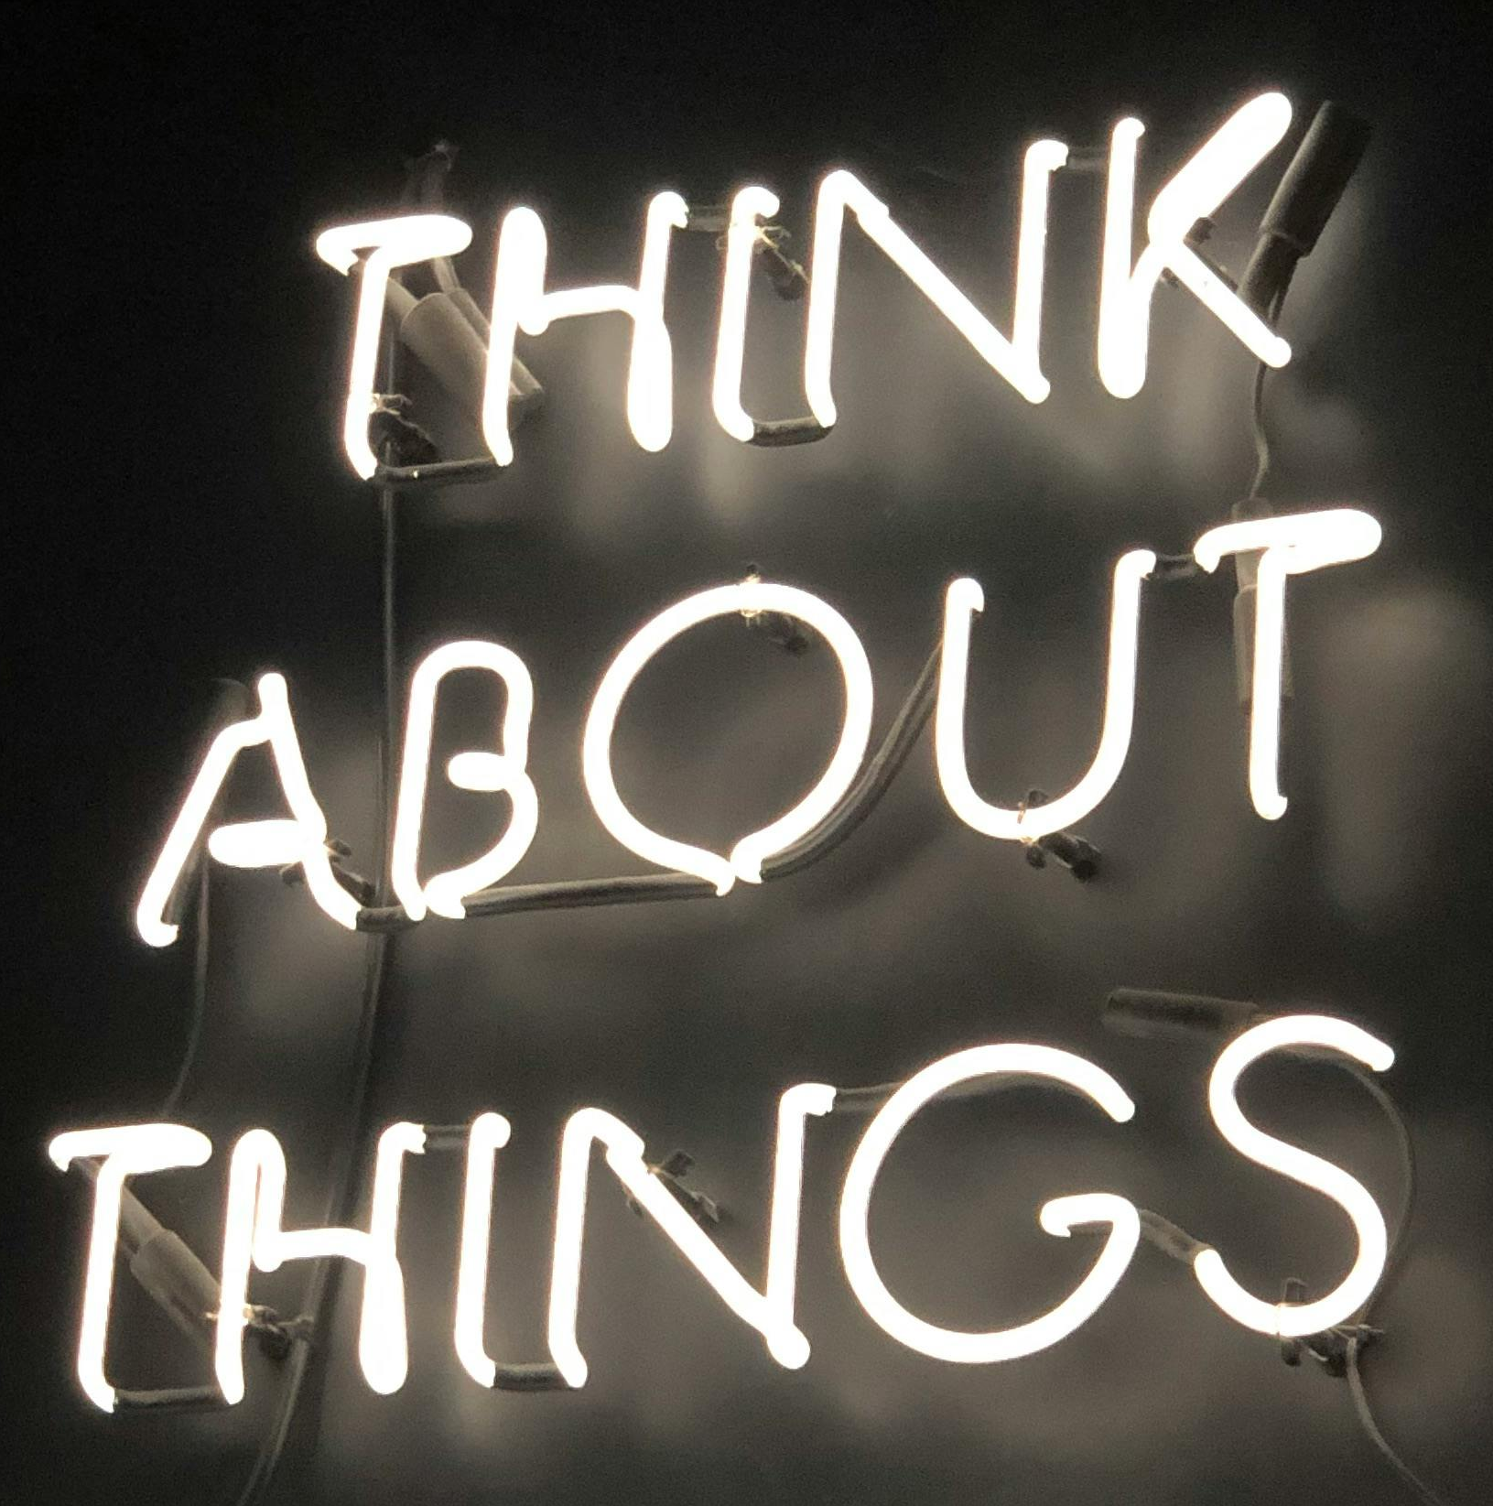
Questions?

Slide 15
Agile project
Lesson 3 – Using the planboard

Slide 16

Weekly sprint planning
  Discussing your goals for the week
Notes:
Een sprint planning is voor een hele sprint waarin (een gedeelte van) de backlog items (user stories) wordt gerefined.

Slide 17
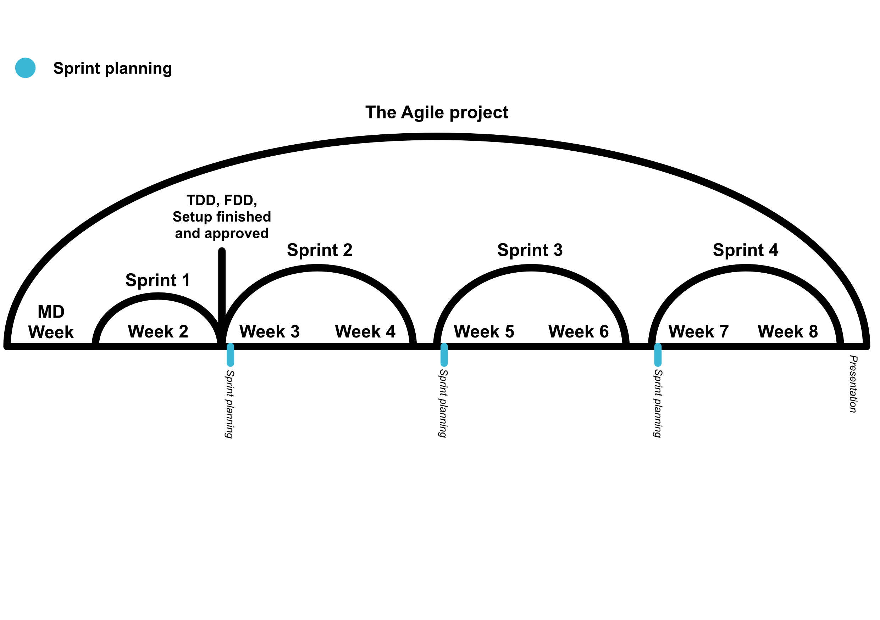
You’re here

Slide 18
To do’s
A user story consists out of more than one task
During the weekly sprint planning, you’ll convert the user stories that you want to do that week into to-do’s
  This can be done by using AI again, make sure to check if the task list is complete and correct
  You don’t assign anyone to the tasks yet, this will be done during the daily stand-up.

Slide 19
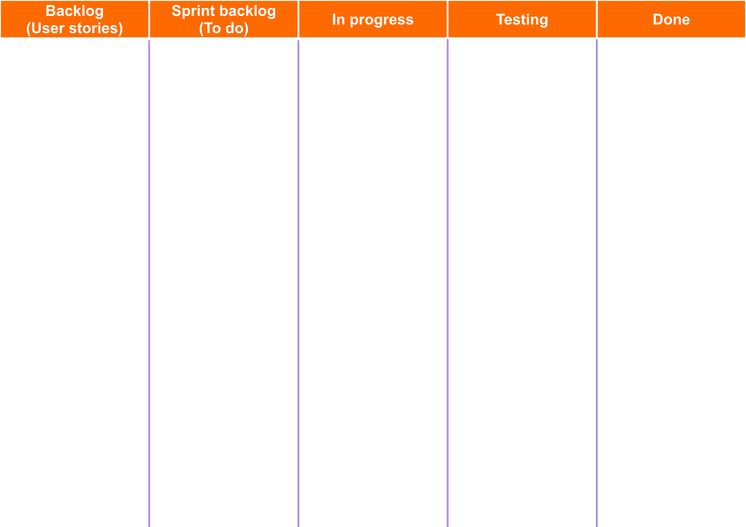
Implement a share button
Add a “copy link” option for sharing
As a user I would like to share posts to other apps so that my friends can still see them without an account
Create a public post view without needing an account
Should have

Slide 20
Daily stand-up
  Discussing your goals for the day

Slide 21
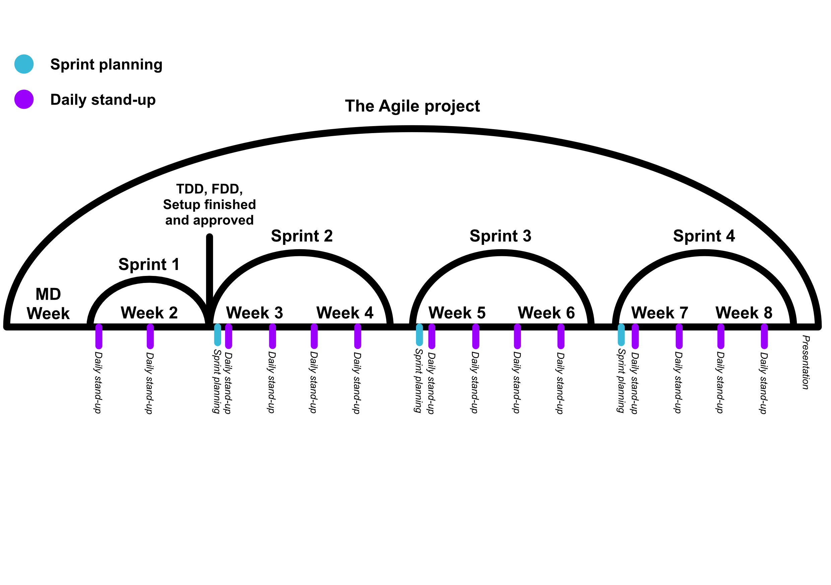

Slide 22
Daily stand up
Discuss what the plans are for the day
  Which tasks does the group want finished at the end of the day?
  Who’s going to be assigned those tasks?
  Put those tasks in the progress column with a name attached

Slide 23
Implement a share button
Lars
Add a “copy link” option for sharing
Lars
As a user I would like to share posts to other apps so that my friends can still see them without an account
Create a public post view without needing an account
Luc
Should have

Slide 24
Tests
Before you say anything is done, someone (that didn’t do the task) has got to test it first.
They decide if it’s fully done, if it isn’t it goes back to the to-do list with the feedback attached.

Slide 25
Add a “copy link” option for sharing
Lars
Implement a share button
Lars Luc
As a user I would like to share posts to other apps so that my friends can still see them without an account
Create a public post view without needing an account
Luc
Should have

Slide 26
Questions?

Slide 27
Agile project
Lesson 5 – Code reviews

Slide 28
Code review
  Getting code checked by a senior employee

Slide 29
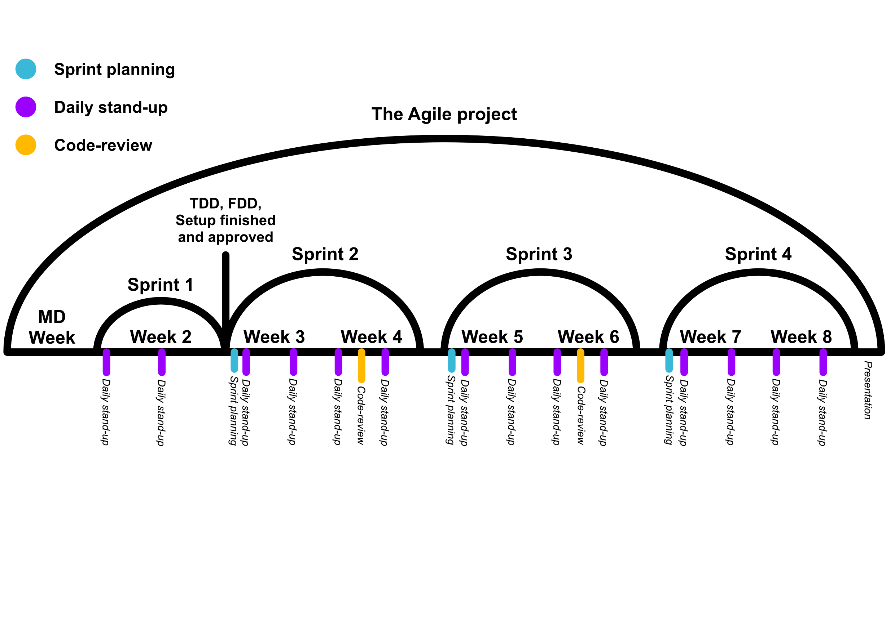
You’re here

Slide 30
Code reviews
At the end of the sprint, a senior developer (in your case your teacher) will check the code from your finished tasks.
They will give feedback, with which you will create new tasks based on that feedback.

Slide 31
Questions?

Slide 32
Agile project
Lesson 6 – Reviews and Retrospectives

Slide 33
Review
  Meeting with the client about process and further plans

Slide 34
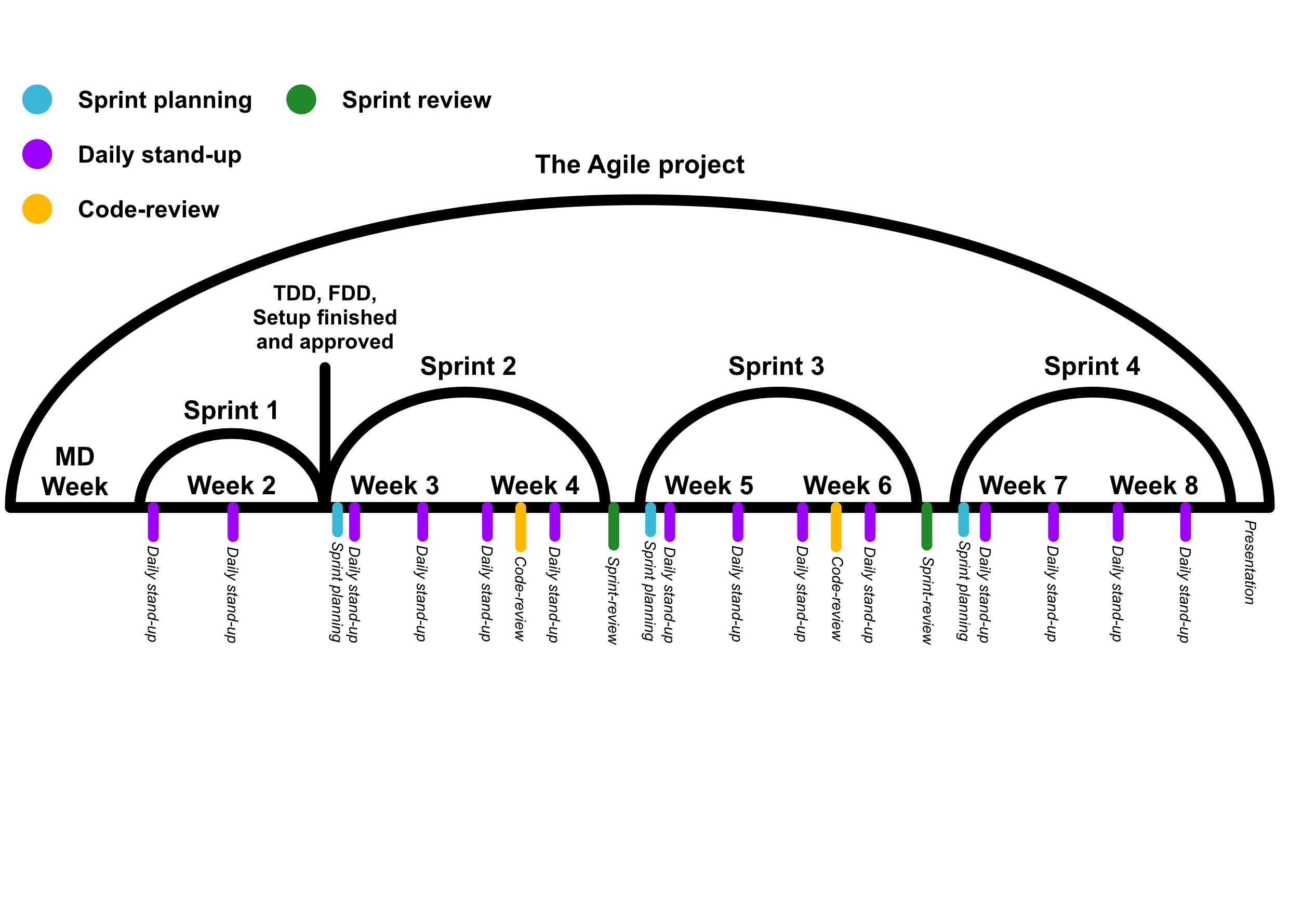
You’re here

Slide 35
Sprint review
At the end of the sprint, you will sit together with your client (also in this case your teacher) to show the current state of the product
They will give feedback based on what their expectations are/were
You’ll discuss what the next steps are, where the priorities lie, and if the scope of the project needs to be changed.
Notes:
Iets over het opschrijven van de feedback door de student?

Slide 36
Retrospective
  Discussing how the team is doing

Slide 37
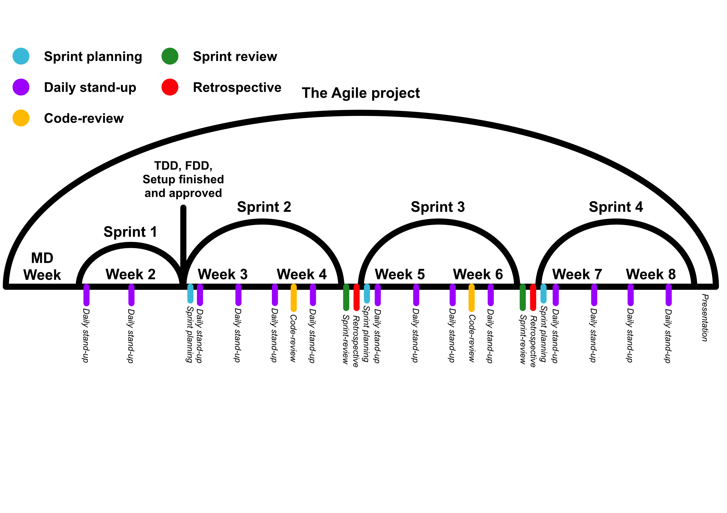

Slide 38
Retrospective
At the end of the sprint, you will sit together with your team and a senior (also the teacher) to discuss how well you as a team worked this sprint.
You’ll pick out points which went well and discuss how to keep this going.
You’ll also pick out points which could’ve gone better and how to avoid this in the future.
Notes:
Is altijd met de klant (de stakeholders). Scrum master-student is verantwoordelijk voor het verloop.

Slide 39
Questions?

Slide 40
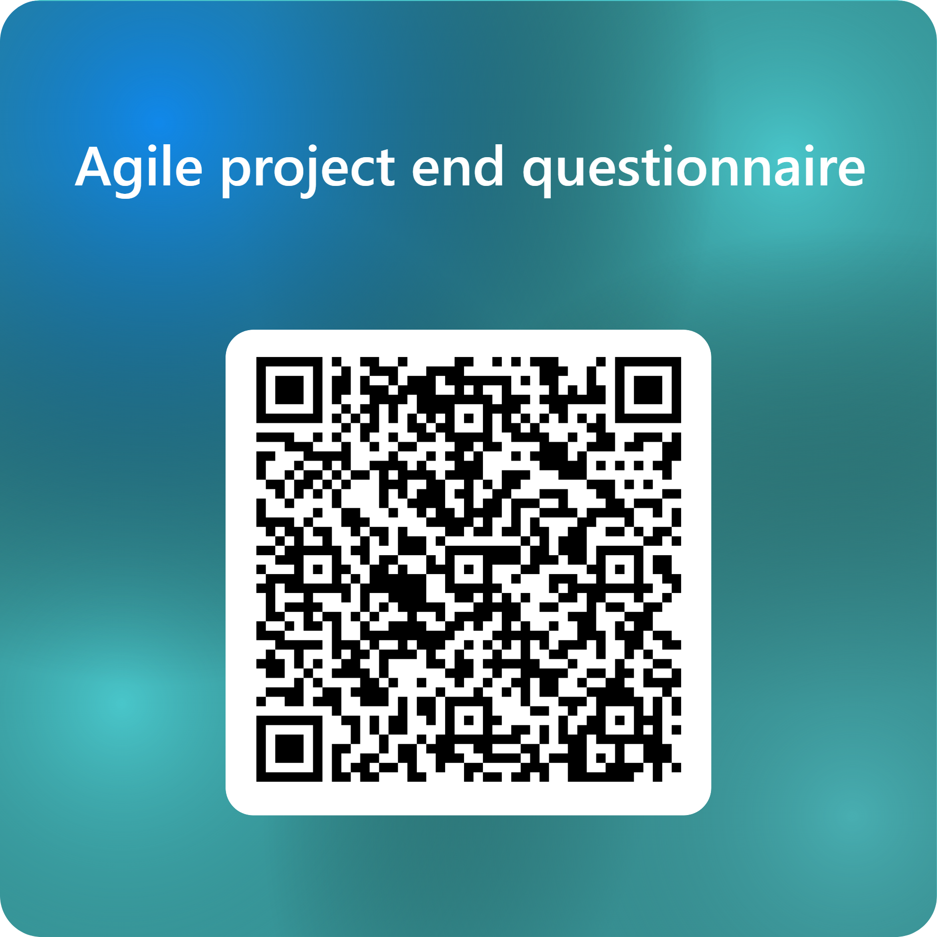

Slide 41
Thanks!

